Slide 1
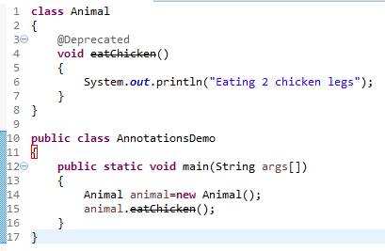

Built-In Annotations in java - @Override
@Deprecated annotation marks that this method is deprecated so compiler prints warning.
@Deprecated informs user that it may be removed in the future versions. So, it is better not to use such methods.

